Slide 1
Session 5: Quick Sort, Heap Sort

Slide 2
Agenda
Quick Sort
Heap Sort
Summary

Slide 3
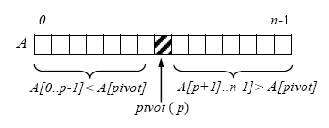
Quick Sort
Basically, quicksort works as follows:
If the input array has less than two elements, there is nothing to do.
Otherwise, do the following partitioning subroutine: Pick the first element as pivot and divide the array into two subarrays. The first subarray contains items whose key is smaller than or equal to the pivot and the second items whose key is greater than or equal to the pivot.
Sort the two subarrays recursively.

Slide 4
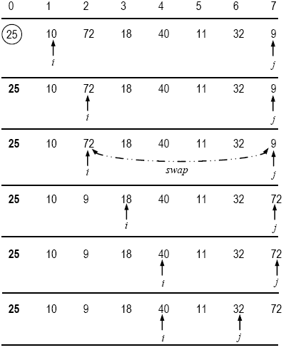

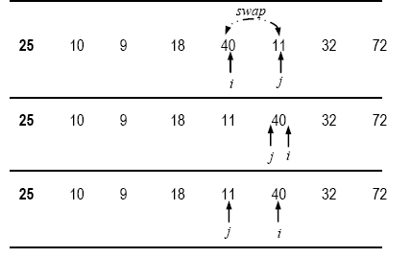
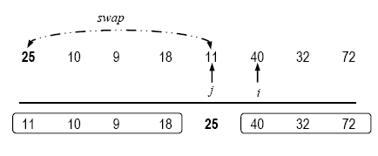
Example

Slide 5
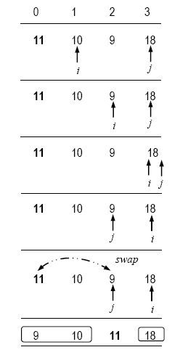
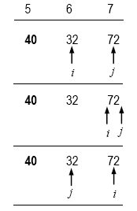

Example…

Slide 6
Algorithm - Quicksort
■ Algorithm QuickSort(A[0..n – 1], i, j)
// Input: Array of numbers A[0..n – 1]
// Output: Sorted array A
// i, j: lower and upper bounds of a subarray
if i < j
// partition the given list into two segments
q ← Partition(A, i, j)
QuickSort(A, i, q) // sort Subarray 1
QuickSort(A, q + 1, j) // sort Subarray 2
end QuickSort.

Slide 7
Algorithm - Partition
■ Algorithm Partition(A[p..r], p, r)
// Input: Array A, p and r: lower and upper bounds of the array
// Output: Position for swap with pivot
pivot ← A[p]
i ← p
j ← r + 1
while true do
do i = i + 1 while A[i] < pivot
do j = j – 1 while A[j] > pivot
if i < j
Swap(A[i], A[j]) // A[i] ↔ A[i]
else
return j
end Partition.

Slide 8
Final QS Algorithm
■ Algorithm QS(A[p..r], p, r)
// Input: Array A, p and r: lower and upper bounds of the array
// Output: Sorted array A
if p < r
pivot ← A[p]; i ← p; j ← r + 1
while true do
do i = i + 1 while A[i] < pivot
do j = j – 1 while A[j] > pivot
if i < j
Swap(A[i], A[j]) // A[i] ↔ A[j]
else
break // partition is over
A[p] = A[j]
A[j] = pivot
QuickSort(A, p, j-1) // sort Subarray 1
QuickSort(A, j+1, r) // sort Subarray 2
end QS.

Slide 9

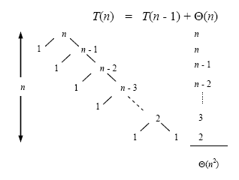
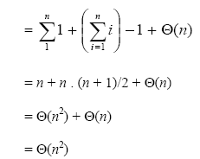
Complexity - Worstcase

Slide 10
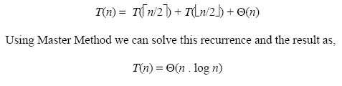
Bestcase

Slide 11
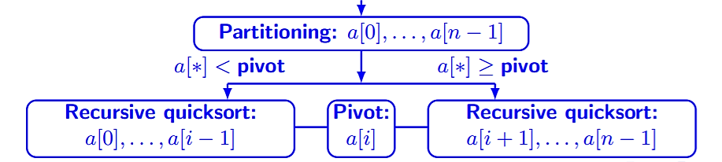
Average Case Analysis

Slide 12
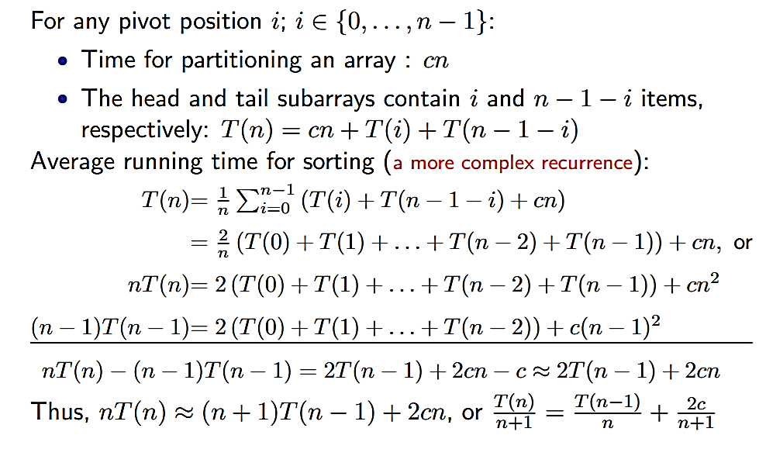
Average case…
In the average-case, the list may not be exactly partitioned into two halves
The pivot element may be placed at any position in the array.

Slide 13
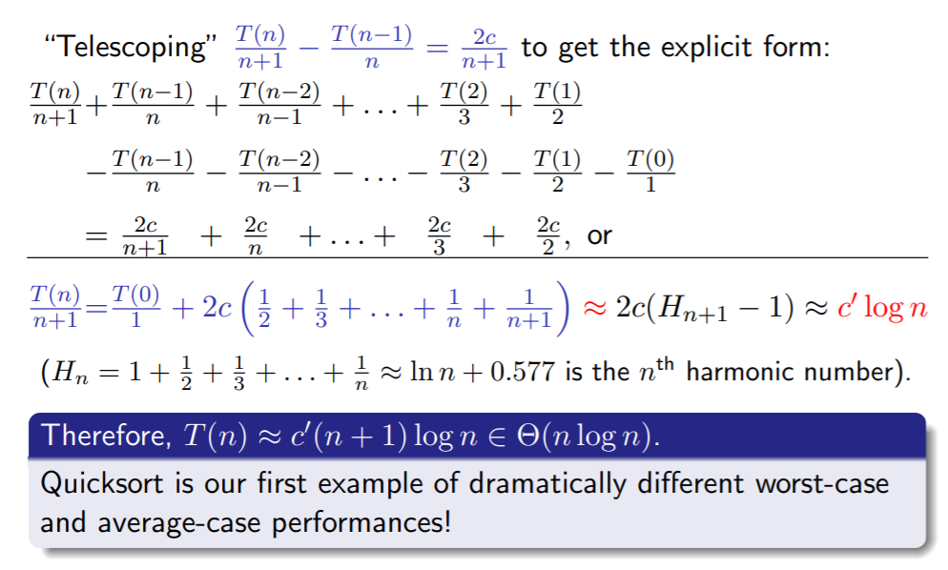
Average Case…

Slide 14
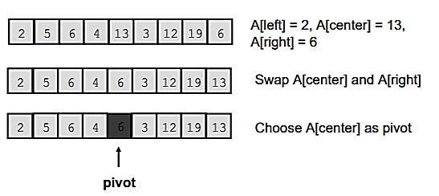
Choice of Pivot Element
First, or Last, or Middle, or Random
Median-of-Three
Compare just three elements: the leftmost, rightmost and center
Swap these elements if necessary so that
A[left] = Smallest
A[right] = Largest
A[center] = Median of three
Pick A[center] as the pivot

Slide 15
Heaps
A max heap is a tree (need not be a binary tree) that satisfies the following properties:
Every leaf node is of height h or h - 1.
Every leaf node of height h appears to the left of every leaf node of height h – 1.
The value in each node is greater than or equal to those in its children (if any).

Slide 16
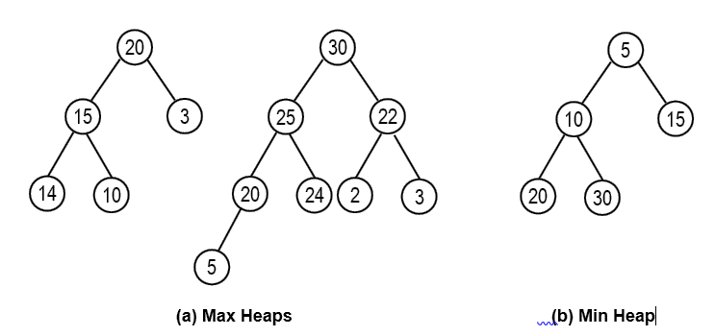
Example

Slide 17
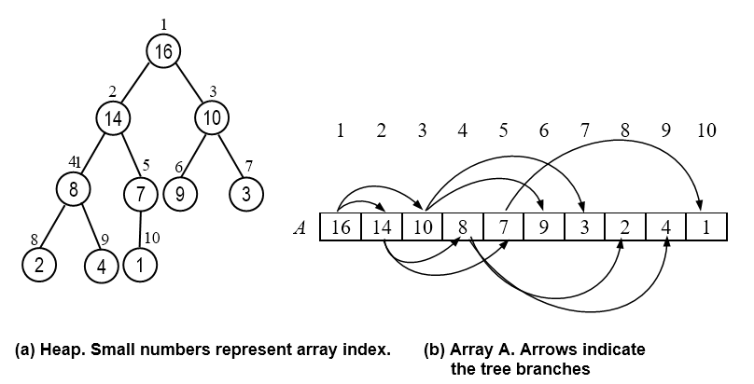
Heap using Arrays
Root of tree is A[1]
Left child of A[i] = A[2i]
Right child of A[i] = A[2i + 1]

Slide 18
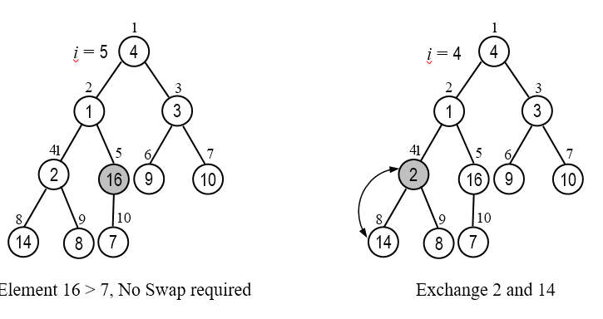
Heap Construction

Slide 19
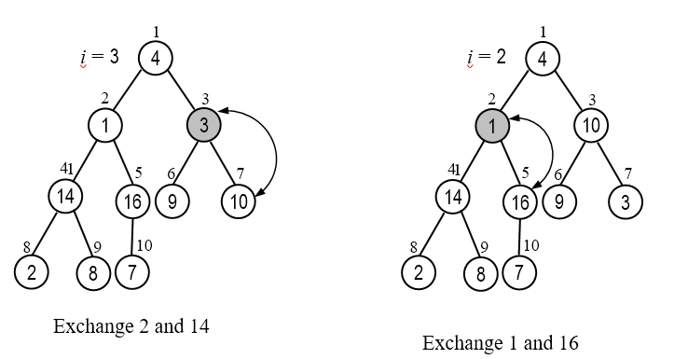
Contd.

Slide 20
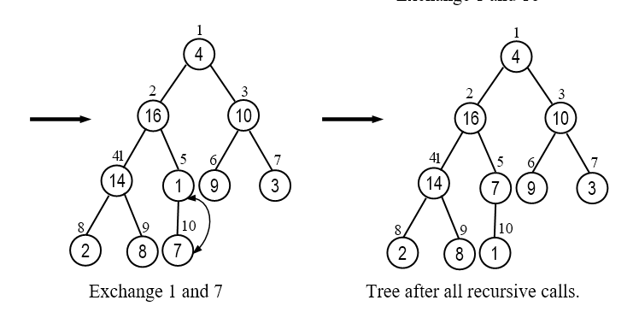
Contd.

Slide 21
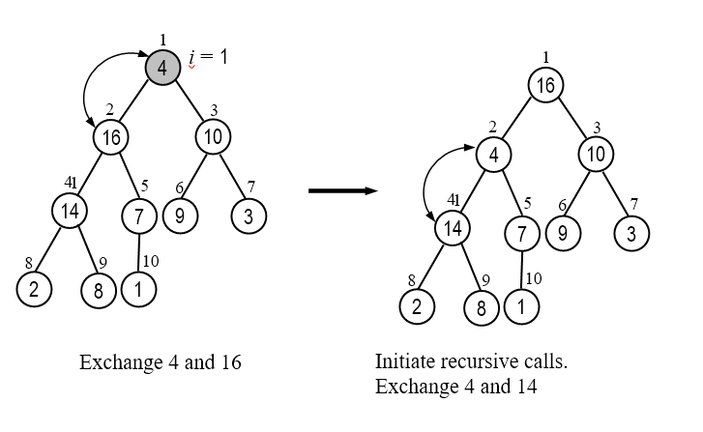
Contd.

Slide 22
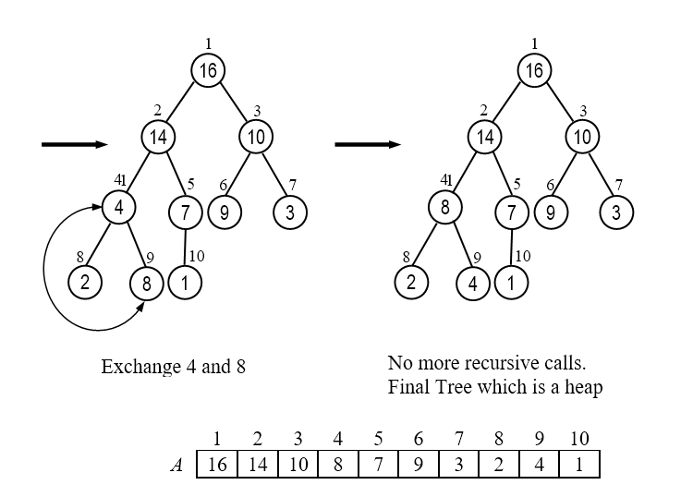
Contd.

Slide 23
Algorithm
i will take the root

Slide 24
Building a complete heap of A

Slide 25
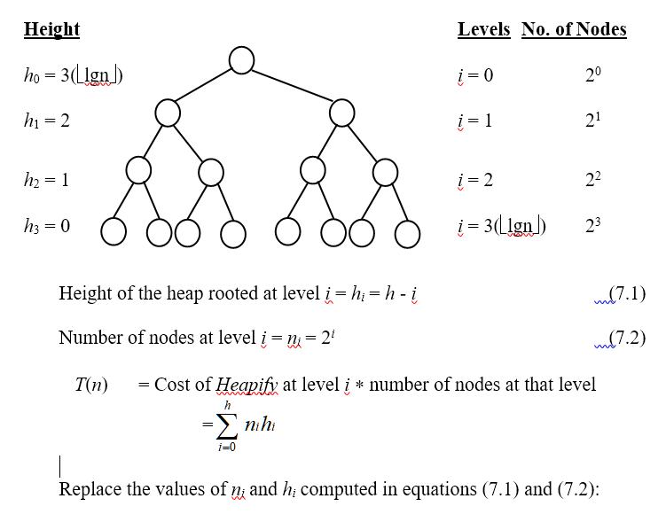
Analysis

Slide 26
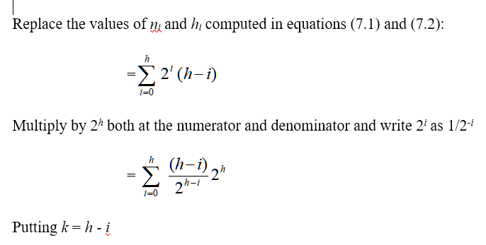
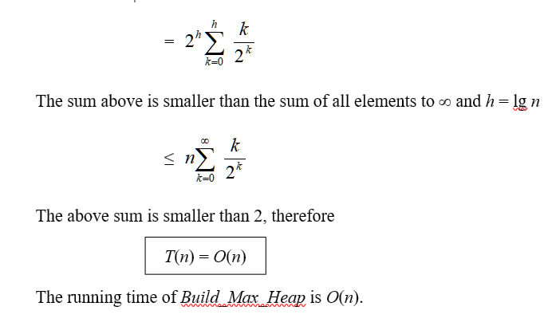
Contd.

Slide 27

Alternate Method
There are no more than ⌈n/2^{h+1}⌉ nodes of height h, and the heap is ⌊lg n⌋ high.
MAX-HEAPIFY called on a node of height h is O(h), so we need to sum this cost times the number of nodes at each h for all relevant h:

Slide 28

Contd.
We can simplify this as follows:
Wrap big-O around the whole thing, leaving h behind.
Remove the ceiling (which does not affect big-O analysis).
Rewrite the resulting nh/2^{h+1} as (n/2)(h/2^{h}).
Move n/2 out of the summation, as it does not involve h.
Eliminate the constant 1/2, as we are inside the magical world of big-O!
=

Slide 29


Contd…
The above summation runs up to ⌊lgn⌋, but we would like to use a convenient formula A-8, shown below, which runs up to ∞:
Since big-O implies an inequality (upper bound), we can go ahead and run the summation to ∞ instead of ⌊lgn⌋, because all of the additional terms are positive (and also very small), so the inequality will be maintained. Then, if we let x = 1/2 (since h/2h = h(1h/2h) can be written as h(1/2)h), we get:
Thus our big-O expression simplifies to O(n*2) = O(n)

Slide 30
Max heap - Insertion
Step 1: Insert the new element in the next available location
Step 2: Call Heapify( ) function
25
25
25
20
3
20
3
20
3
16
5
16
16
5
1
5
1
Initial heap
Insert 1
No Change required

Slide 31
Insert 10
25
25
25
20
3
20
3
20
10
16
5
16
5
10
16
5
3
Initial heap
Insert 10,
Swap with 3
Final heap

Slide 32
Insert 30
25
25
25
20
20
3
30
20
3
16
16
5
30
5
3
16
5
Insert 30,
Swap with 3
Swap 25 and 30
Initial heap
30
20
25
16
Final heap
5
3

Slide 33
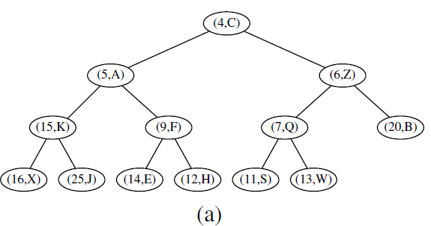
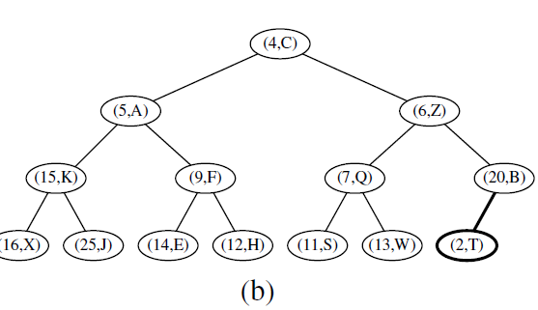
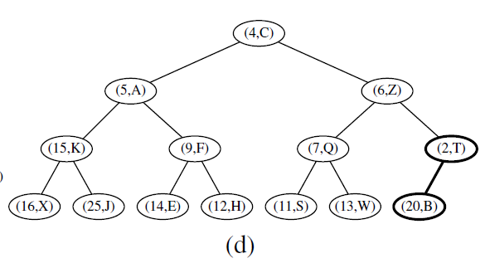
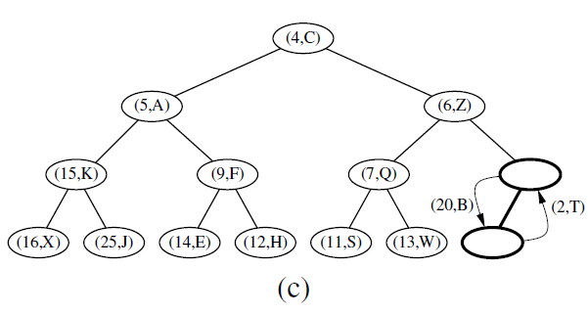
Example-2: Min Heap (Insert Key 2)

Slide 34
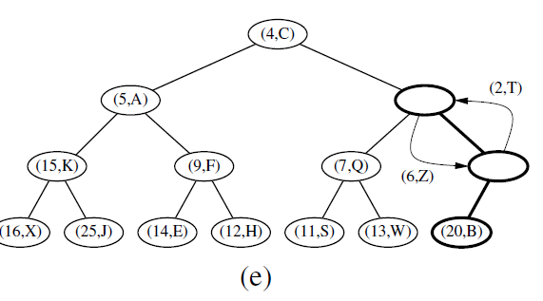
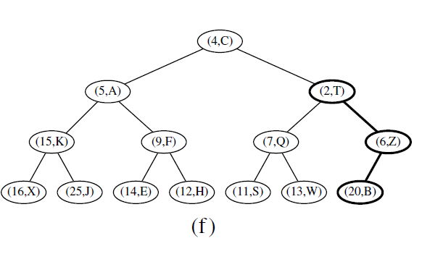
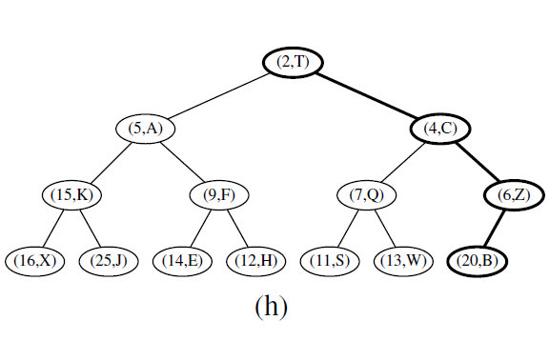
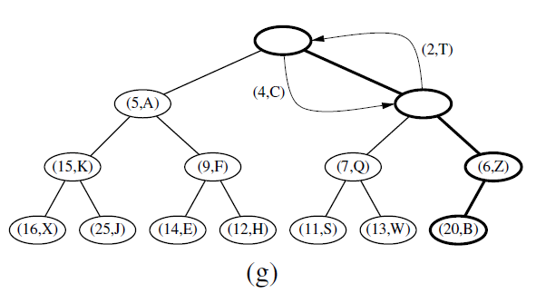
Cont.

Slide 35
Max Insert Function
Algorithm Max_Insert(A, n, x)
if (n = MAX)
print (“Error. Heap is Full”)
return
i = n + 1
while (i != 1 AND x > A[i/2]) do
A[i] = A[i/2]
i = i/2
A[i] = x
return.
15
12
8
10
14

Slide 36
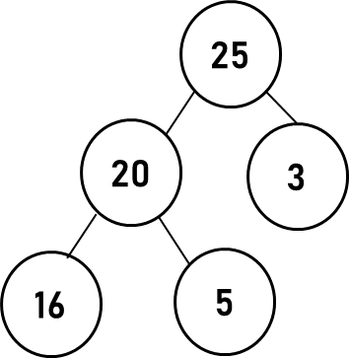
Max Delete
25
20
3
16
5
25
20
3
25
3
16
5
20
3
16
5
5

Slide 37
Max Del Function
Algorithm Max_Delete(A, n)
// Input: A: an array representing a heap
// Output: The maximum element of A and A as a heap
with this element removed
// Running Time: O(log n) where n = heap size of A
max = A[1]
A[1] = A[n]
n = n - 1
Max_Heapify(A, 1, n)
return max
25
20
3
16
5

Slide 38
Heap Sort
void HeapSort (int a [], int n)
{
int i;
InitializeHeap(a, n); /* heap a */
for (i = n; i >= 1; i--)
a[i] = MaxDelete(a, &n);
}

Slide 39
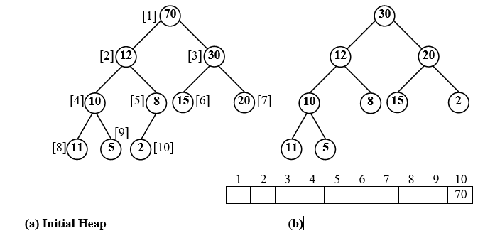
Working of Heap Sort

Slide 40
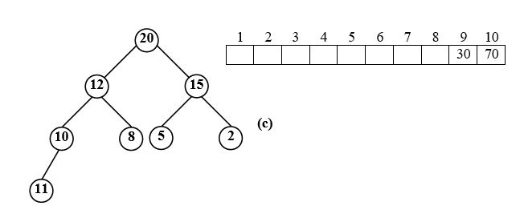
Contd…

Slide 41
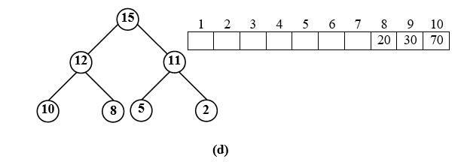
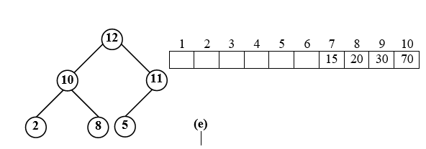
Contd…

Slide 42
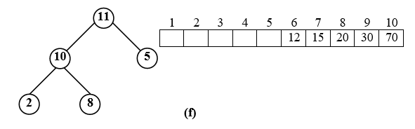
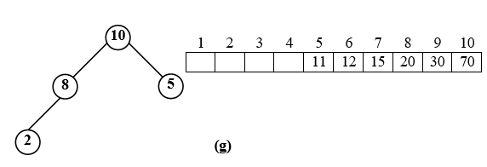
Steps…

Slide 43
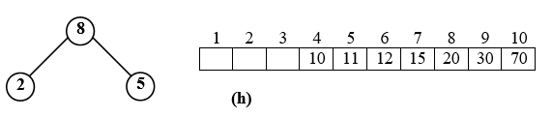
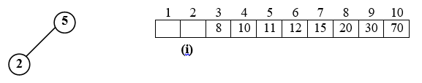
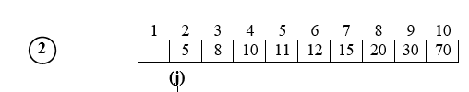

Steps…

Slide 44
Running time of Heap Sort
InitializeHeap(a, n);
for (i = n; i >= 1; i--)
a[i] = MaxDelete(a, &n); // calls max_heapify()
Building the max-heap from the unsorted list requires O(n)
Each of max_heapify function takes O(log n) time.
Thus, the running time of heapsort is
= O(n) + O(n log n) = O(n log n).

Slide 45
Summary

